Slide 1

What is the GirlScript Foundation?

Slide 2



GirlScript Foundation
GirlScript is a section-8 NON PROFIT company registered under the government of India on the 2nd of June, 2017.
GirlScript is open for all organization and supports beginners in technology and programming.
It supports diversity by reserving 50% seats for women & IGBT in all it's programs worldwide.

Slide 3
Our Goal
1. To educate people in tech
2. Remove myths about tech education
3. Spread awareness about opportunities in tier two & tier three cities
4. Introduce tech content that is helpful for everyone

Slide 4

The Founder & CEO-Anubha Maneshwar
Forbes 30 Under 30 She has been featured in Forbes Under 30 Asia List of 2020 under the Social Entrepreneurs category.
IWL Excellence Award Winner of the Indian Women Leadership Excellence Award.
Best Startup 35 Under 35 35 Under 35 Awards in Best Startup for Education Category.
India's Top 100 Young Leaders Award.
Mentor at Mozilla Open Leaders Program, Learn IT Girl, PyCon North America and Speaker at Tedx

Slide 5
GirlScript Bangalore Chapter
Our chapter leads are Shaina Parvanda and Prachitesh Priyatosh.
They promote the goals of the GirlScript Community all over Bangalore and help the students to learn and grow.
And who am I?

Slide 6

Campus Hero- Mount Carmel College
I am Jasleen Sondhi. And I am representing GirlScript Bangalore at Mount Carmel College!
Fun tech events, webinars and hackathons await you this year!

Slide 7

Getting Started with Git and GitHub

Slide 8

Agenda
What is Git and GitHub?
What is Version Control System?
Understanding GitHub workflow
Role of GitHub
Important Concepts for the GitHub Users
Setting up GitHub
GitHub Demo

Slide 9
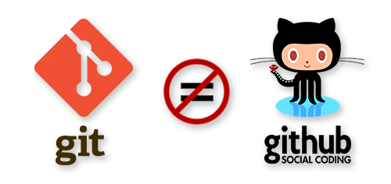
Git is not GitHub!

Slide 10


What is Git and GitHub?
To understand GitHub, we must first have an understanding of Git.
Git is an open-source version control system that was started by Linus Torvalds—the same person who created Linux.
GitHub is a United States-based global company that provides hosting for software development and version control using Git.
It is a repository hosting service for Git.
While Git is a command line tool, GitHub provides a Web-based graphical interface.

Slide 11
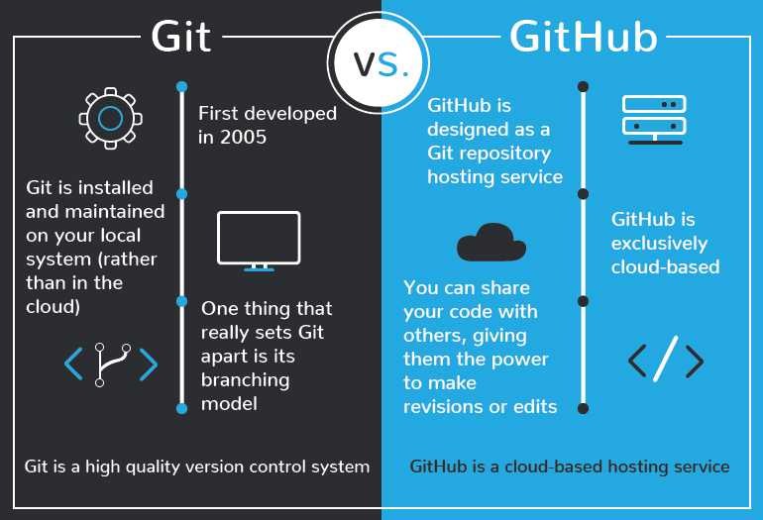

Slide 12
What is a Version Control System?
Version control systems are a category of software tools that help a software team manage changes to source code over time.
It keeps track of every modification to the code in a special kind of database.
Version control enables multiple people to simultaneously work on a single project.
Each person edits his or her own copy of the files and chooses when to share those changes with the rest of the team. Thus, temporary or partial edits by one person do not interfere with another person's work.

Slide 13
Understanding GitHub Workflow

Slide 14
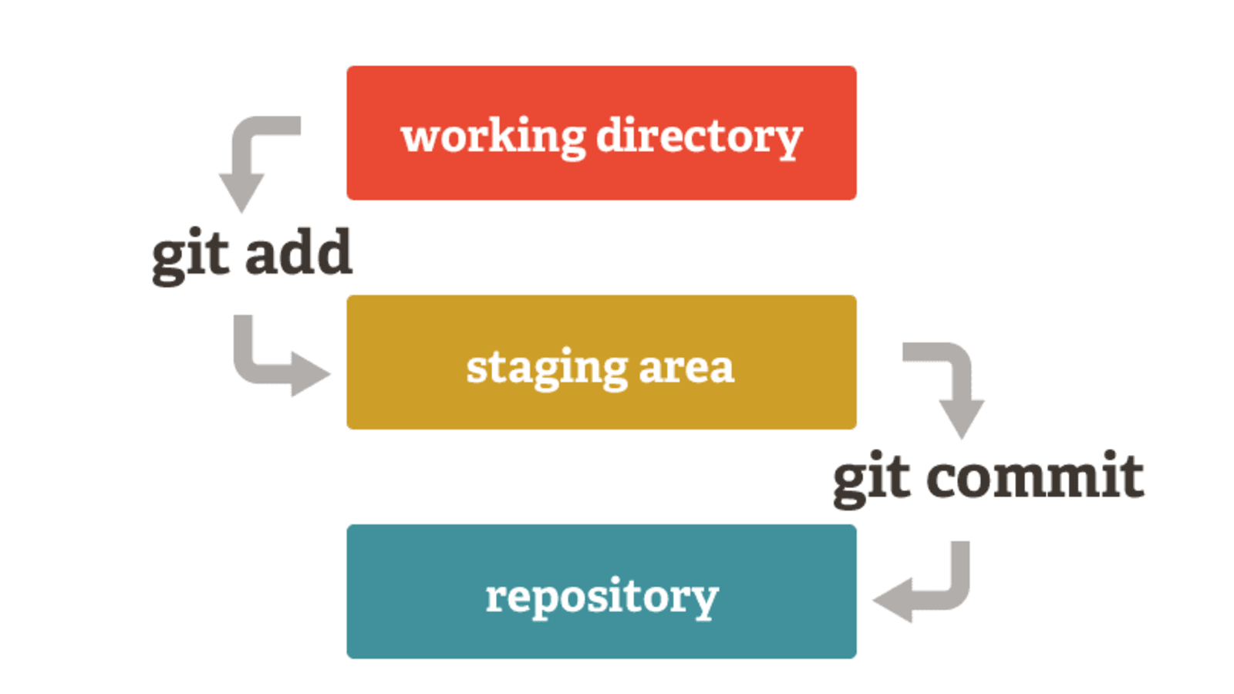

Slide 15
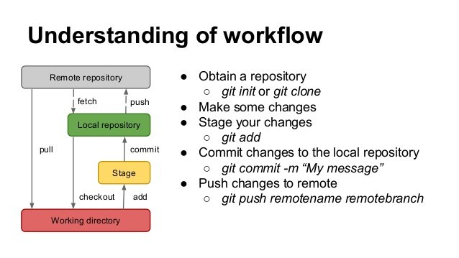

Slide 16
Role of GitHub
Let’s watch a short video by Google Women Techmakers to understand this better!
https://www.youtube.com/watch?v=NHwiSlz4Bi4#action=share

Slide 17
Important Concepts for the GitHub Users
First of all, we need to fork. In GitHub, all you need to do is click that fork button and you get your own personal repository to your GitHub user account.
When you want to actually work on your repository you need to clone it to your computer, and now you own two repositories: one remote on GitHub and one local on your computer.
When you want to actually work on your repository you need to clone it to your computer, and now you own two repositories: one remote on GitHub and one local on your computer.
Git repositories are organized with tags and branches. A branch is a way to keep lines of development separate. The default branch in git is usually named master.

Slide 18
Some Basic Commands-
git config
git init
git status
git add
git add –m “commit message”
git push
git pull
git clone

Slide 19
Setting up Git and GitHub
Installing Git
Open the Git website
Click the Download link to download Git. The download should automatically start.
Once downloaded, start the installation from the browser or the download folder.
Setting up a GitHub account-
Go to https://github.com/join
Type a user name, your email address, and a password.
Choose Sign up for GitHub, and then follow the instructions.

Slide 20
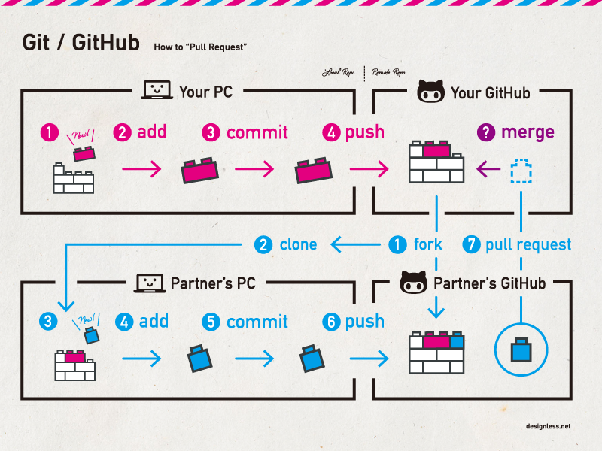
GitHub Demo

Slide 21

Thank you!

